Slide 1

The Rise of Evil

Slide 2

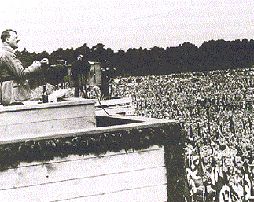
Support for the Nazi Party
Over 6 million Germans voted for the Nazi Party in the 1930 election. The number doubled over the next two years.
Why?
People voted for them because they agreed with their ideas.
They supported the Nazi’s blaming Germany’s problems on the Jews and the Weimar politicians who signed the Treaty of Versailles.

Slide 3
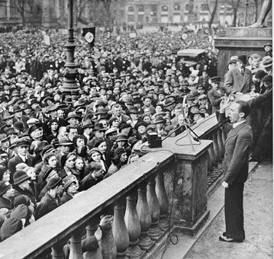
Support for the Nazi Party
The Nazi’s used propaganda to drum up support of the people.
Joseph Goebbels was in charge of propaganda, using every method he could to get maximum publicity for the Hitler.
He made records, films, displayed posters and flags, held mass rallies where Hitler would speak.
The Nazis also used the SA to gain support, beating up Communists and breaking up their meetings.

Slide 4
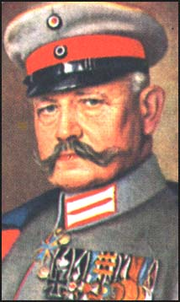
1932 Elections
In 1932 there were 3 elections, one for the Presidency, the others for the Reichstag.
Presidency Election
Field Marshal Paul von Hindenberg (84), who didn’t represent a party won, Hitler received the second most votes. Thalman from the Communist Party received the third most.

Slide 5
1932 Elections
Reichstag Elections
The SA stepped up their violent campaign during this election.
99 people were killed and 1125 were wounded in street fights across Germany during the election campaign.
The results were a great victory for Hitler.
The Nazis were now the biggest party in the Reichstag.
Results for the July Election
Nazi Party | 230 seats
Social Democrats | 133 seats
Centre Party | 97 seats
Communist Party | 89 seats

Slide 6
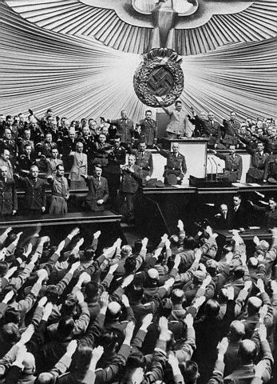
1932 Elections
As the largest party in the Reichstag Hitler demanded to be made Chancellor.
Hindenberg refused to give him the post. He did not want the power of the Reichstag to be given to a new party with its violent political methods.
Hindenberg allowed present Chancellor Franz Von Papen to stay in office, using his powers to make Papen’s decisions law. Papen only had the support of 97 seats in the Reichstag.

Slide 7
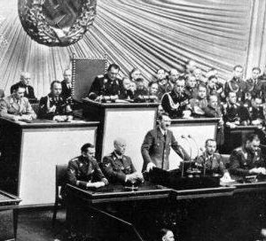
1932 Elections
The newly elected Reichstag met in September to vote on whether it had confidence in Papen. 32 members voted yes, 513 voted no.
Faced with opposition Papen arranged another election in November to get more support in the Reichstag.
The results were a slight improvement for Papen. There was a drop in Nazi votes (remained the biggest party).
Hitler again demanded to be Chancellor, Hindenberg refused, allowing his friend Papen to stay in the job.

Slide 8
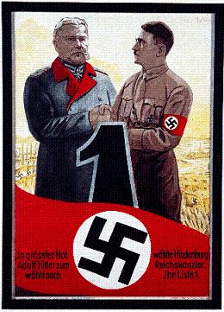
Hitler’s Rise to Power
After the reappointment of Papen in November:
Kurt von Schleicher one of Hindenberg’s advisors, told him that the army would not support Papen staying in office, threatening a general strike, even civil war.
Hindenberg had to get rid of Papen, appointing Schleicher as Chancellor.
Schleicher lasted 57 days, the Reichstag would not support his decisions either.
Hindenberg had no choice but to appoint Hitler Chancellor, this occurred on 30th January 1933.

Slide 9
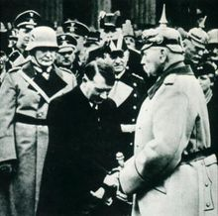
Hitler’s Rise to Power
While Hitler seemed on his way to take control of Germany there were some obstacles in his way.
Firstly Germany was a democracy, laws could only be made if the Reichstag supported them. As more than half the government was made up of parties who opposed Hilter, making it difficult legalise his policies.
Secondly Hitler owed his position to Hindenberg, who could easily make him resign if he disagreed with Hitler’s decisions.
Hitler therefore had to be careful about the careful about how he got rid of his opponents.

